Slide 1
Git

Slide 3
Source Control

Slide 4
Source Control
Improve collaboration
Enable parallel development
Minimize integration debt
Manage versions with the ability to roll back
Build DevOps processes
Notes:
Track and manage changes to code (scripts, modules, etc)
Allows for version tracking
Enables the ability to roll back to an earlier version if there is a problem
Aides with managing updates to scripts that live on servers or are used by other engineers
Collaboration without the headache
Everyone has to integrate their changes, and those changes can be rolled back
Can get the most up-to-date version of any file at any time
Technical (integration) debt is the accumulation of sub-optimal technical decisions made over the lifetime of an application. Eventually, it gets harder and harder to change things: it’s the ‘sand in the gears’ that sees IT initiatives grind to a halt. Manual release and manual testing lend themselves far too easily to technical-debt workarounds: servers and test machines with one-of-a-kind, handcrafted environment settings, politely ignoring (or turning off) error messages, and special handling of special cases. The process of automating these tasks forces the DevOps implementation team to confront such workarounds, with a choice between incorporating them (and the technical debt that they represent) into the new, automated system, or eliminating them, along with the underlying debt.

Slide 5
DevOps Mindset
Plan
Build
Deploy
Operate
Feedback
Continuous Integration Continuous Delivery
Enable continuous delivery for rapid feedback and improvements
Harmonize development and operations teams to work together
Process focused to provide smoothest experience
Requires shift in mindset and company culture

Slide 6

Distributed version control system
Lightweight and fast
Open Source
Supports parallel development (branching)
Notes:
Source: https://git-scm.com/
Git is a free and open source distributed version control system designed to handle everything from small to very large projects with speed and efficiency.
Git is easy to learn and has a tiny footprint with lightning fast performance. It outclasses SCM tools like Subversion, CVS, Perforce, and ClearCase with features like cheap local branching, convenient staging areas, and multiple workflows.
Created in 2005 by Linus Torvalds

Slide 7
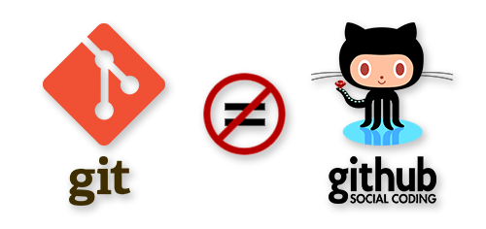
Git vs. GitHub
Git: The source control system
GitHub: A hosting service for Git repositories, only stores code
Notes:
Many other Git repositories exist but GitHub is one of the most popular.
Others include:
Bit bucket
Git lab
Azure DevOps services/server

Slide 8
Git Basics

Slide 9
Git Keywords - Basics
Repository: Represents main project (Repo)
Staging: Files with changes ready to save
Committing: Snapshots of changes in staging area
Notes:
The repository holds all the files and tracks their change history
Stage area is where you put files you want to save changes for once you’re happy
Committing saves a snapshot of all your changes and can be *tracked* in the repository

Slide 10
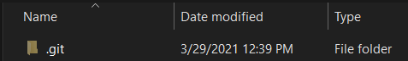
Create Repository
Created with command: git init
Git creates a .git folder
.git folder contains information needed for Git to function
To remove Git, remove the .git folder and retain all project files
Create New – git init <RepositoryName>
PS c:\> git init MyNewRepository
Initialized empty Git repository in C:/MyNewRepository/.git/

Slide 11
Git Process
Files are created / edited in workspace
To track a file, it first must be added to the staging area
Staged files can then be committed (snapshot of current staging area)
Create New File(s)
Add to Staging Area
Commit File(s)

Slide 12
Adding Content to Staging Area
Add a file to staging area: git add <filename>
Add all files to staging area: git add .
View what is staged: git status
PS c:\MyNewRepository> git add .\script.ps1
PS c:\MyNewRepository> git status
On branch main
No commits yet
Changes to be committed:
(use "git rm –cached <file>... " to unstage)
new file: script.txt

Slide 13
Removing File From Staging Area
PS c:\MyNewRepository> git rm .\script.ps1 –cached
Rm 'script.ps1’
PS c:\MyNewRepository> git status
On branch main
No commits yet
Untracked files:
(use "git add <file>..." to include in what will be committed)
script.ps1
Nothing added to commit but untracked files present (use "git add" to track)

Slide 14
Commits
Snapshots repository with staged changes
Logs email address and username if it is remote repository
Contains message describing changes
Commit has unique hash which is used as reference

Slide 15
Committing Changes
Commit all changes: git commit –m “<commit message>”
PS c:\MyNewRepository> git commit –m "Made a small change"
[main 67b2b30] Commit
Date: Tue Apr 10 16:21:50 2018 +1000
1 file changed, 0 insertions(+), 0 deletions(-)
create mode 100644 script.ps1
Use –amend switch to change last commit
PS c:\MyNewRepository> git commit –m "Altered commit" –amend
[main 67b2b30] Altered commit
Date: Tue Apr 10 16:21:50 2018 +1000
1 file changed, 0 insertions(+), 0 deletions(-)
create mode 100644 script.ps1

Slide 16
Common Options For Viewing History
Command line: git log
Built-in GUI: gitk
GitHub
VSCode extensions:
Git lens
Git file history
Git graph

Slide 17
History With Git Log
PS c:\MyNewRepository> git log
Commit ebf96ff9862bc450a4b61c48742c0ec64639d1c (HEAD -> main)
Author: Anthony Watherston <anwather@contoso.com>
Date Tue Apr 10 16:25:40 2018 +1000
Made a small change
Commit 67b2b30e8cc6b8167ba947a55440730951ac44bq
Author: Anthony Watherston <anwather@contoso.com>
Date Tue Apr 10 16:25:40 2018 +1000
Altered commit
PS c:\MyNewRepository> git log --oneline
ebf96ff (HEAD -> main) Made a small change
Commit 67b2b30 Altered commit

Slide 18
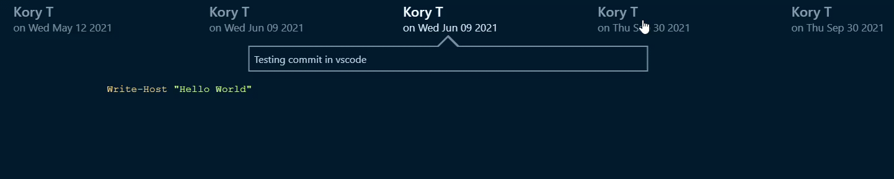
Git File History Extension
Extensions allow for easily browsing changes through commits
File content
Commit info
Notes:
Git File History: https://marketplace.visualstudio.com/items?itemName=pomber.git-file-history

Slide 19

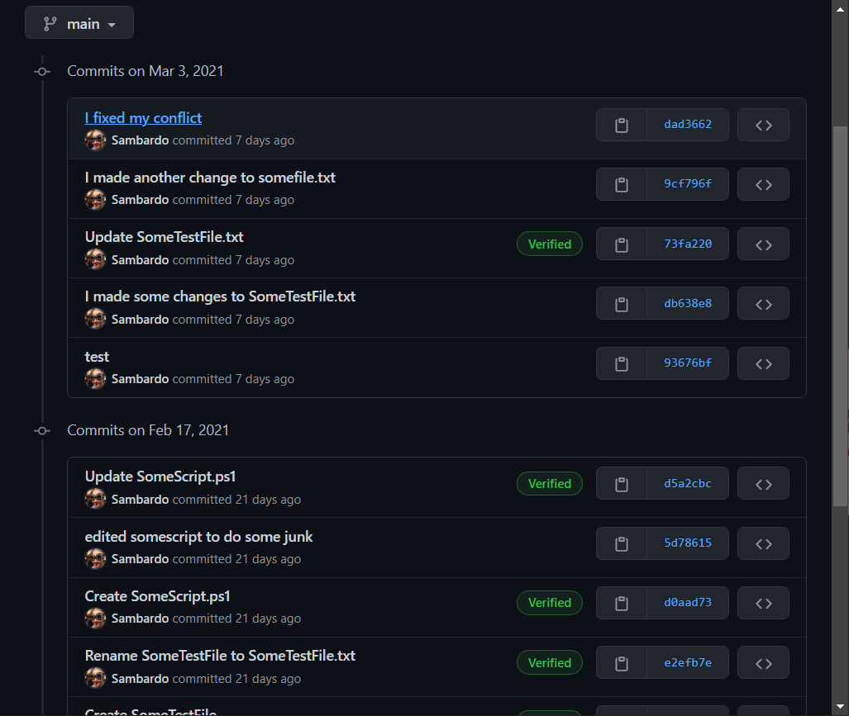

Slide 20
Working with Remote Repositories

Slide 21
Remote Repository Overview
Central location for main project team is working on
Changes are made and committed to local repository as normal
Local commits are pushed to remote repository
Updates are pulled from remote repository to local repo
Conflicts occur when the same file is modified in asynchronous commits
Notes:
Conflicts occur if someone made changed to a file that you ALSO changed, so you need to integrate their changed with your changed before you can commit.

Slide 22
Git Process
Make changes locally
Add to Staging Area
Commit locally
Pull changes from remote repository
Resolve any conflicts locally
Push commit to remote repository
Performing a push before a pull will give errors on conflicts and won’t complete
Pull before pushing to integrate changes
Push and pull frequently to reduce conflicts
git fetch and git status can be used to check what changes have been made remotely
Notes:
Conflicts occur if someone made changed to a file that you ALSO changed, so you need to integrate their changed with your changed before you can commit.

Slide 23
Push
PS> git status
On branch main
Your branch is ahead of 'origin/main' by 3 commits.
(use "git push" to publish your local commits)
nothing to commit, working tree clean
PS> git push
Enumerating objects: 11, done.
Counting objects: 100% (11/11), done.
Delta compression using up to 16 threads
Compressing objects: 100% (8/8), done.
Writing objects: 100% (9/9), 792 bytes | 792.00 KiB/s, done.
Total 9 (delta 5), reused 0 (delta 0), pack-reused 0
remote: Resolving deltas: 100% (5/5), completed with 2 local objects.
To https://github.com/Sambardo/DemoRepo.git
5d91da5..48f68d7 main -> main
Notes:
Make a local change to a file
git status
git push
Show the file in github

Slide 24
Pull
Fetch is used to check what changes happened remotely
PS> git fetch
remote: Enumerating objects: 5, done.
remote: Counting objects: 100% (5/5), done.
remote: Compressing objects: 100% (2/2), done.
remote: Total 3 (delta 1), reused 0 (delta 0), pack-reused 0
Unpacking objects: 100% (3/3), 650 bytes | 8.00 KiB/s, done.
From https://github.com/Sambardo/DemoRepo
48f68d7..74264e7 main -> origin/main
PS> git status
On branch main
Your branch is behind 'origin/main' by 1 commit, and can be fast-forwarded.
(use "git pull" to update your local branch)
PS> git pull
Updating 48f68d7..74264e7
Fast-forward
SomeTestFile.txt | 2 +-
1 file changed, 1 insertion(+), 1 deletion(-)
Notes:
Make a change to a file in github
git status
git fetch
git status
git pull
Show the file locally

Slide 25
Conflicts
PS> git push
To https://github.com/Sambardo/DemoRepo.git
! [rejected] main -> main (fetch first)
error: failed to push some refs to 'https://github.com/Sambardo/DemoRepo.git’
PS> git pull
remote: Enumerating objects: 5, done.
remote: Counting objects: 100% (5/5), done.
remote: Compressing objects: 100% (3/3), done.
remote: Total 3 (delta 1), reused 0 (delta 0), pack-reused 0
Unpacking objects: 100% (3/3), 676 bytes | 6.00 KiB/s, done.
From https://github.com/Sambardo/DemoRepo
74264e7..ef05d78 main -> origin/main
Auto-merging SomeTestFile.txt
CONFLICT (content): Merge conflict in SomeTestFile.txt
Automatic merge failed; fix conflicts and then commit the result.
Notes:
We learn how to resolve conflicts in the lab, but feel free to show it here too.
Change file on desktop and commit
Change file on github and commit
git push
git pull
Resolve conflict if you want

Slide 26
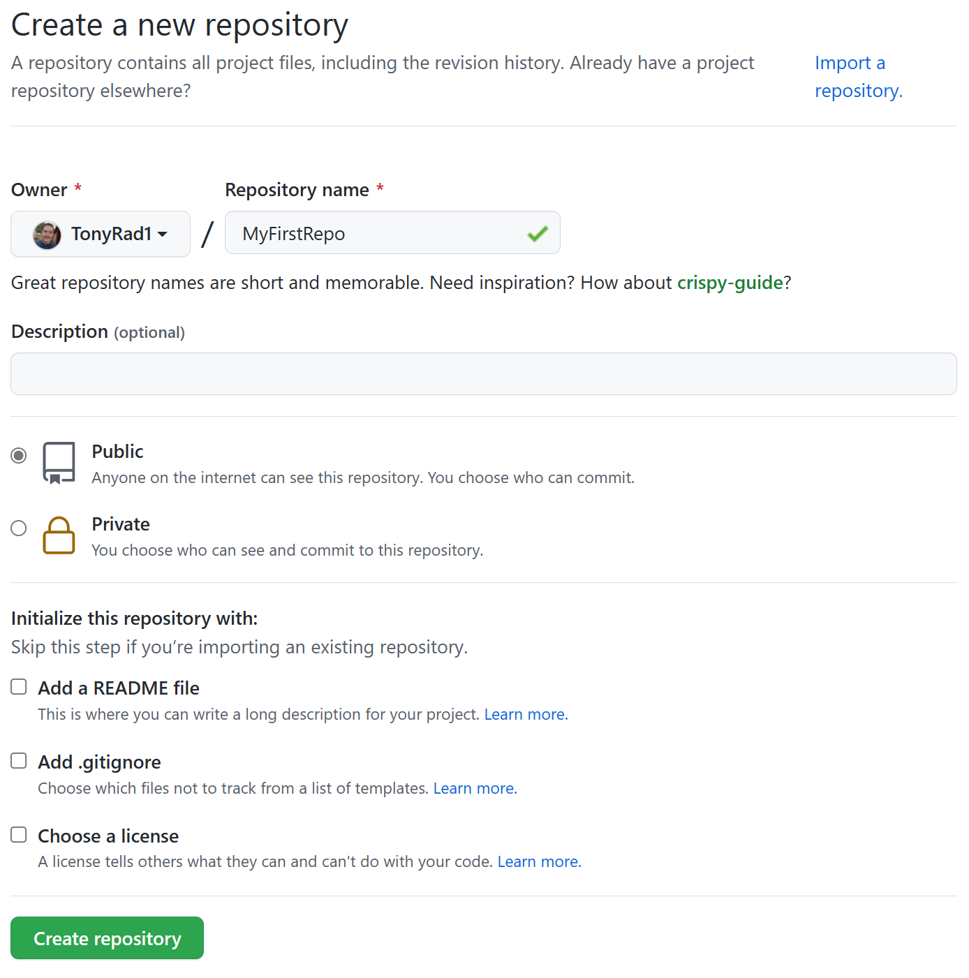
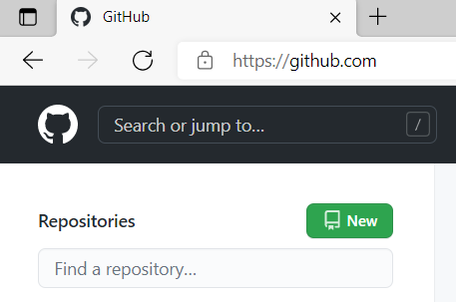
Creating A GitHub Repository
Unique name
Description
Private or Public
Optional README
Option gitignore
Notes:
The descriptions are short and appear on the side of the project web page
Readme files are in markdown and displayed by default on the page
Gitignore files let you exempt files from tracking

Slide 27
Cloning Remote Repository
Obtain a copy of an already created project
Generally, a one-time operation for a machine
Create and navigate to the local folder
PS> git clone https://github.com/Sambardo/DemoRepo.git
Cloning into ‘DemoRepo’ ...

Slide 28
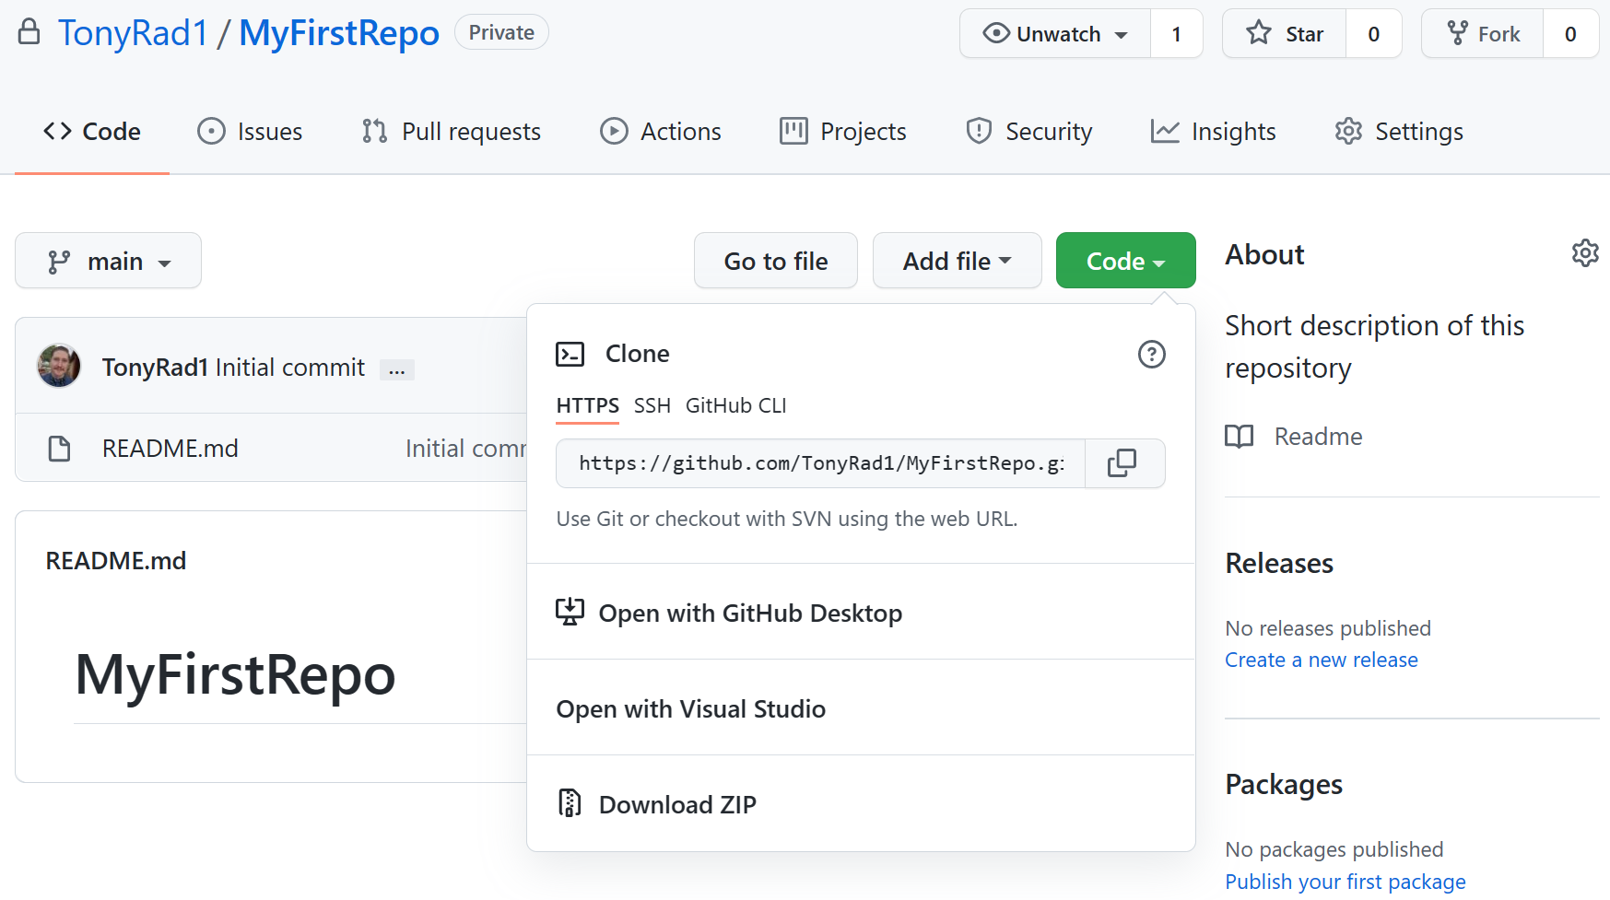
Cloning a Repository From GitHub
Clone options show under code dropdown
URL to clone
PS> git clone https://github.com/TonyRad1/MyFirstRepo.git
Cloning into ‘MyFirstRepo’ ...

Slide 29
Branching and Merging

Slide 30
Branching and Merging Overview
Independent copy of the current repo with specific requirements
Used for fixing bugs, developing new features, etc.
Merged back into main like a pull/push when work is complete
Prevents disturbing the main line of work

Slide 31
Commands
Create a new branch: git branch BranchName
Do both in one step: git checkout –b BranchName
Merge code FROM a branch INTO current branch: git merge BranchName
Switch to a branch: git checkout BranchName
Delete a branch: git branch –d BranchName

Slide 32
Branch Strategies
Keep them simple
Use feature branches for new features or bug fixes in large projects with many teams
Use release branches on larger multi-version projects
Keep a high quality, up-to-date main branch that always builds
Merge changes from the main branch regularly if working with multiple branches
Use a dev branch to keep in-progress code away from the main branch

Slide 33
Diagrams – Dev Branch
Stable new code merged into main
main
A
D
git merge dev
dev
B
C
Continued development on dev branch
Dev branch commits for new features

Slide 34

Diagrams – Feature Branches
Feature Branch A
Commits
Team A
git merge feature_a
Conflicts flagged
Team B
Main Branch Commit
git merge feature_b
Feature Branch B Commits

Slide 35
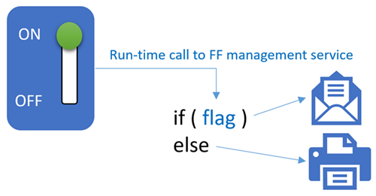
Feature Flags
Alternative to branching
Allows for quick rollback
ON/OFF switch for a specific feature
Feature hidden from users
If ON: send email
If OFF: send to printer

Slide 36
Additional Git Commands
Revert
“Roll back” to an earlier commit, but maintains history
Creates a new commit, which copies the earlier one
Reset
“Roll back” to an earlier commit, but deletes history
Use for undoing local changes, don’t use it on the public repo
Hard removes all data from working directory and staging
Mixed moved all staged files to working directory
Won’t delete commits right away, but will orphan them temporarily
Rebase
Like merge, but rewrites history
Simplifies history, but makes certain commits unreachable and conflicts harder to distinguish
Do not use on public branches
Notes:
Git will permanently delete any orphaned commits after it runs the internal garbage collector. By default, Git is configured to run the garbage collector every 30 days.

Slide 37
Git with Visual Studio Code

Slide 38
Visual Studio Code – Introduction
Supports many programming languages
Multiple versions of PowerShell supported
Code execution and debugging
Source Control Integration
Free
Compatible with all OS’s
Graphical Editor like the ISE
Extension library
Notes:
Visual Studio Code combines the simplicity of a source code editor with powerful developer tooling, like IntelliSense code completion and debugging.
First and foremost, it is an editor that gets out of your way. The delightfully frictionless edit-build-debug cycle means less time fiddling with your environment, and more time executing on your ideas.
Available for macOS, Linux, and Windows:
Visual Studio Code supports macOS, Linux, and Windows - so you can hit the ground running, no matter the platform.

Slide 39
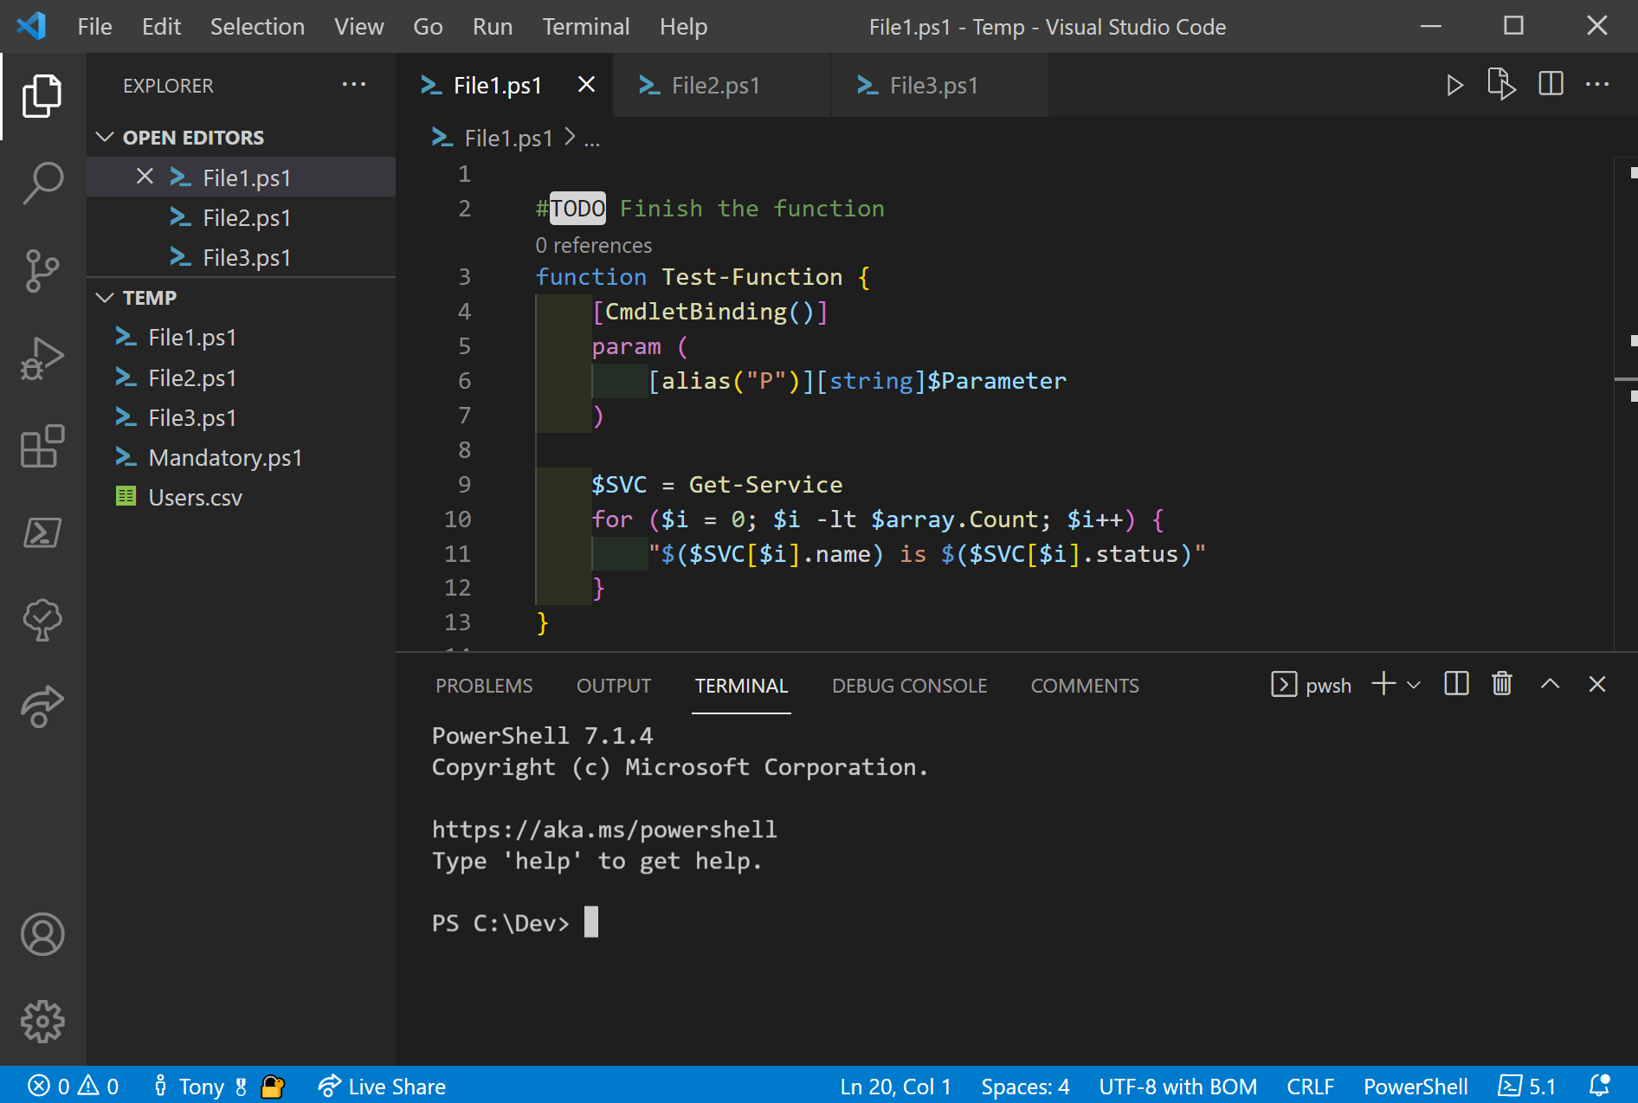
Anatomy of Visual Studio Code
File Browser
Script Panel
Terminal Panel
Notes:
Point out how similar it is to the ISE, but that extensions allow for many new features.
Two different versions of VSC available:
Stable version: Used for production
Insider's edition: side-by-side install allowed

Slide 40
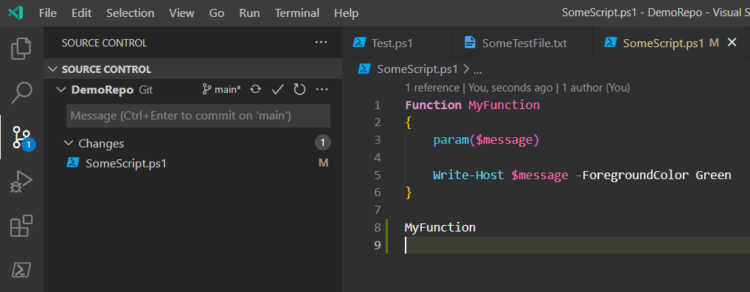
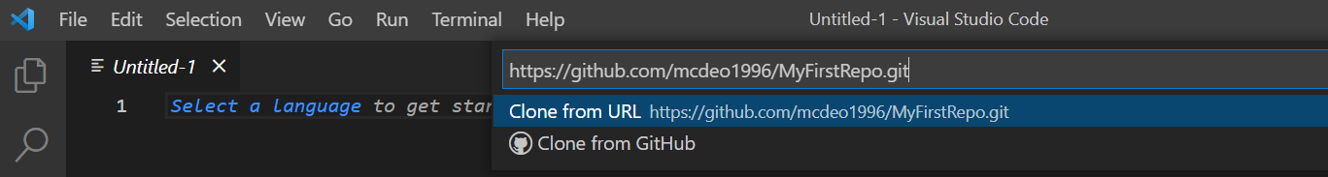
Git With Visual Studio Code
Stage & Commit
GIT
Extension Search
Easily clone
Notes:
Point out the convenient git extensions.
Demo staging, committing, pushing, and conflicts in VSCode

Slide 41
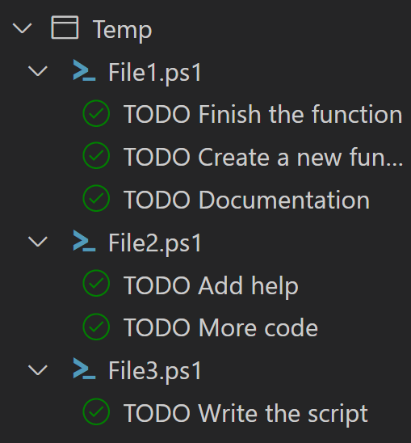
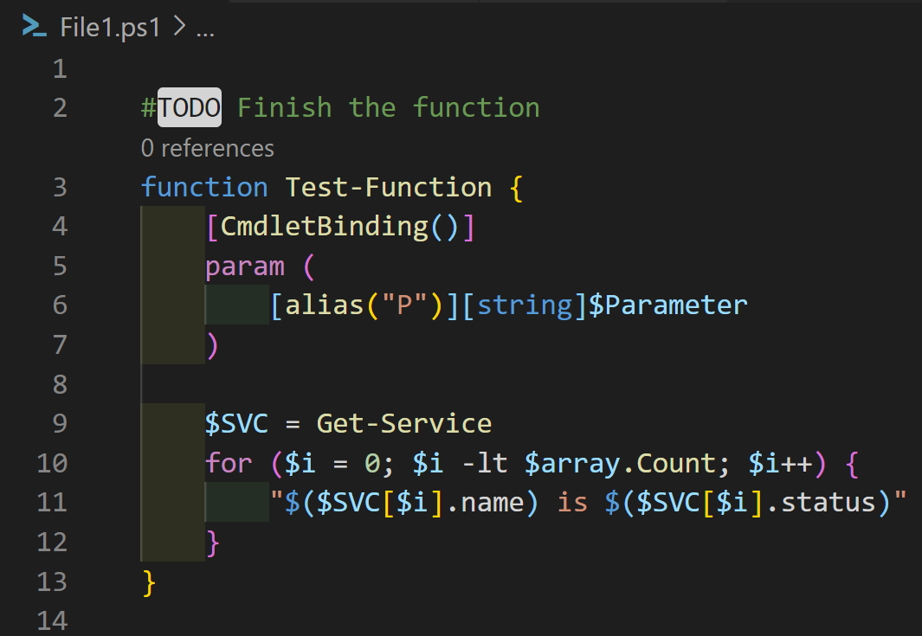
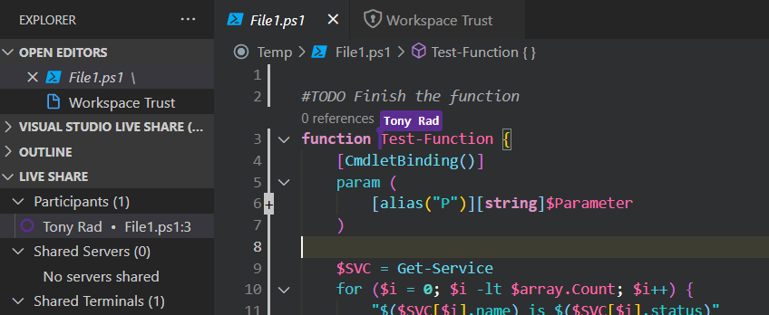
Popular Extensions
Visual adjustments
Bracket Pair Colorizer
Indent-rainbow
Programming languages
PowerShell
Python
Collaboration Tools
Live Share
Keymaps - Hotkeys
Vim
Notepad++
Organization assistance
TODO Tree
Code Spell Checker
File viewers
Markdown
CSV
Notes:
The features that Visual Studio Code includes out-of-the-box are just the start. VS Code extensions let you add languages, debuggers, and tools to your installation to support your development workflow.
Pictures on the side show:
TODO tree flagging TODO comments
Bracket pair colorizer and indent rainbow changing the visuals
Live share session where you can see multiple participants and their cursor locations
Different themes are displayed for syntax highlighting as well
VS Code extensions can be found from the Visual Studio Code Marketplace.

Slide 42

Git (60 minutes)

